Slide 1
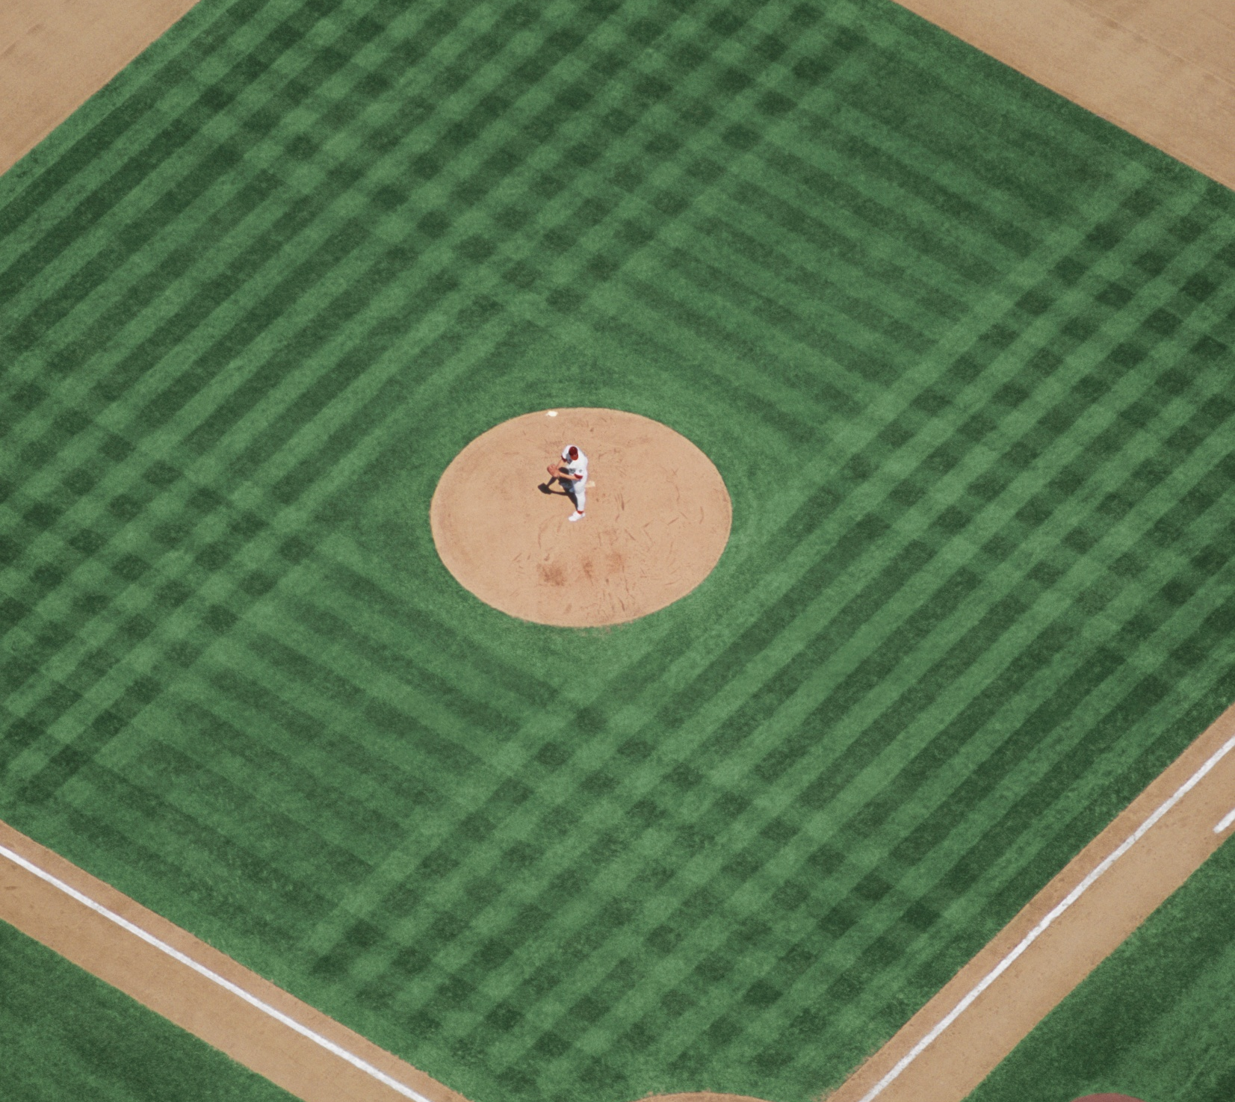
Sparta Youth Baseball Association
Coaches Meeting
February 5, 2026

Slide 2
Purpose of the meeting
Information coaches will need to know for the upcoming season
01
Review new policy highlights for head coaches
02
Review roles, responsibilities, and key duties coaches will need to perform
03

Slide 3
About SYBA
We are a 501(c)(3) nonprofit organization established in 2024
We are not the Sparta Parks and Recreation program
We are not Sparta Baseball Club (adult baseball team)
We are 100% dedicated to youth baseball
Our teams travel (league games and tournaments)
We strive to be a competitive, learning environment
Our goal is to help and support our coaches to enable success

Slide 4
2026 Coaching Volunteers
Age Division | First Name | Last Name | Phone #
08 & Under | Tyrel | Brey | 608-633-1343
08 & Under | Nick | Helgerson* | 608-807-9932
08 & Under | Kyle | Ostrem* | 608-487-0829
08 & Under | Thomas | Vieth | 608-853-0944
09 & Under | Tim | Leis | 608-633-0003
09 & Under | Matthew | Zwolinski | 910-489-8437
10 & Under | Nick | Helgerson* | 608-807-9932
10 & Under | Andrew | Hoeft | 608-317-2805
10 & Under | Kyle | Ostrem* | 608-487-0829
10 & Under | Charles | Stevens | 608-377-4167
11 & Under | Rich | Gerzmehle | 910-920-5301
11 & Under | Lance | Hauser | 608-738-8237
11 & Under | Clay | Kalember | 608-322-2221
11 & Under | Mike | Larsen* | 608-633-4583
12 & Under | Mark | Flaig | 608-633-1697
12 & Under | Brooks | Goplin | 715-299-1826
13 & Under | Mike | Larsen* | 608-633-4583

Slide 5
Essential docs for Coaches on our website SpartaYouthBaseball.com
Head Coaching Policy v1.0
Apply to be a Head Coach
Template – Tournament Request Form
Template – Coach Parent Player Contract
Template – Attendance Tracker

Slide 6
What it means to be a SYBA Head Coach
Purpose & Philosophy
Emphasis on development, sportsmanship, and communication
Who Can Be a Head Coach
Positive conduct, reliability, and availability
Ability to work respectfully with players, parents, and volunteers
Annual background check required
Create a safe, fun, player-first baseball environment
Prior youth coaching or volunteer experience preferred

Slide 7

Coaching responsibilities
Must be a good communicator with parents and players
Must use TeamReach app as your primary communication method with parents Post your practice and game schedules on the calendar with reminders
Use appropriate language when speaking to your team
Do not be under the influence of alcohol or use tobacco products during practices or games
Emphasize good sportsmanship
Be respectful to officials, especially our own... it’s difficult to find and keep them
Utilize parent rep, parents as much as possible when you need help
Take all games seriously (avoid distractions like music and PA systems)
Only coaches and players are allowed in the dugouts during games
Any roster/personnel changes needed after rosters are finalized must be approved by the board. This includes temporary roster additions for a tournament or game.

Slide 8
Additional responsibilities
Each team must have one head coach
Head coaches must work collaboratively with assistant coaches
Head and assistant coaches should be present and available for vast majority of games, practices, and coach meetings
Head coach is responsible for SYBA equipment
Use parent rep, parents as much as possible. Delegate first aid kits, umpire gear, scorebook, GameChanger, etc
Setup practice plans, practice schedule, reserve practice space
Find tournament opportunities and work with the board to register and make payments
Head coach will read and understand all league and tournament rules
Required - Track attendance for practices and games
Required - Keep a scorebook for all your games
Required – Coach, Parent, Player Contract… make it your own

Slide 9
Highlights of the new Head Coaching Policy

Slide 10
Selection & Evaluation Process
How Head Coaches Are Selected
Open head coaching positions will be posted on our social media and/or website
Application + interview with Coaching Selection Committee
Final approval by SYBA Board
Returning coaches in good standing receive priority consideration for the next season
“Priority Consideration” means returning coaches in good standing will be considered first to coach the following season
How Head Coaches Are Evaluated
Annual evaluations at end of the season (seven categories, 1–5 scale)
Minimum score 21/35 = “Good Standing”
Evaluation Categories include:
Commitment Level
Communication with Parents
Baseball Knowledge
Leadership and Managing Assistants
Trustworthiness and Character
Player-first Coaching Approach
Availability

Slide 11
Accountability & Support
Coaches may appeal their end-of-season evaluation if scored below 21
Assistants are given priority consideration to be head coach for the next season if a head coach’s evaluation is <21 (not in good standing)
If no assistants are willing or available, the position shall be opened and posted to SYBA social media and/or website to other qualified volunteer candidates.
Serious misconduct or unsafe behavior by coaches = grounds for immediate removal
SYBA is looking for positive leaders, not perfect coaches. If you care about kids, communicate well, and show up — we’ll support you.

Slide 12
Time Commitment (Realistic Expectations)
Practices: 2–3x/week (spring), 1–2x/week (summer)
Games: ~2x/week
Tournaments
Dev teams: 2-3 weekends
Comp teams: 5-6 weekends
April–August season, with minimal absences expected

Slide 13
Preseason Planning for Coaches
Points to consider
When and where will you practice?
Space is limited and you’ll need to coordinate with Sparta Parks & Rec if you want to reserve space to practice
League Game Dates – know which days of the week your team will be playing so you can prepare parents
Tournaments – start searching for potential tournaments you’d like to participate in
Seven Rivers tournaments https://www.bgclax.org/local-tournaments
InfoSports.com
Include these in your Coach/Parent/Player contract to minimize attendance issues

Slide 14
Parent Reps
Goal is to have a least one parent rep per team
We will ask for PR volunteers on the player registration
We may need coaches to help find a PR if no one volunteers
We will have a preseason meeting for PRs to talk thru the role and responsibilities
Coaches use PR as a resource to help you deal with the administrative aspects of baseball
Tournament duties
Concessions
Team banners
Team outings
Uniforms
Umpire gear

Slide 15
Rosters
Need to conduct tryouts for the Competitive teams (mid March -> early April)
Those who do not earn a roster spot will be assigned to a developmental team
Board to meet with coaches after tryouts are completed to finalize the rosters
Finalize who will be the head coach for each team
Number of teams will be dependent upon how many kids register
Ensure each team has adequate number of players (12 is the ideal number)
Some kids will have to “play up” a higher age level; we need your help to understand who is the right fit
All rosters are final at the end of the meeting
Any roster changes must be approved and handled by the board
Be careful borrowing players from other SYBA teams!
We will provide coaches and parents with final rosters and contact info for each child via email

Slide 16
Player Registrations as of 2/4/26
2026 No-Tryout/Developmental Team Registration | Division Name | Division Enrollments
 | 08 & Under | 15
 | 09 & Under | 3
 | 10 & Under | 4
 | 11 & Under | 2
 | 12 & Under | 6
 | 13 & Under | 9
 | 14 & Under | 1
 | Total | 40
2026 Tryout/Competitive Team Registration | Division Name | Division Enrollments
 | 09 & Under | 6
 | 10 & Under | 8
 | 11 & Under | 16
 | 12 & Under | 5
 | Total | 35

Slide 17
Emergencies
Keep a copy of your team’s full roster and contact information with you so you can contact parents in an emergency
Work with your parent rep to handle emergencies that arise
SYBA will provide 1 first aid kit per team

Slide 18
Practice
Head coach will collaborate with assistant coaches to determine practice schedule, frequency, venue, etc.
We suggest 2-3 times per week in the preseason and once or twice per week after games begin
We suggest practicing on the same nights you play games if possible; this will greatly simplify planning for you and parents and establish a routine
Players are expected to be at practice unless excused in advance
Missing practice should have an impact on playing time or starting the game on the bench
Head coach is responsible to ensure practice space is reserved
Note – Reserving gym space is not possible on short notice

Slide 19
Seven Rivers Athletic Association (SRAA) - League Information
Run by the BGC of La Crosse
https://www.bgclax.org/seven-rivers-athletic-association
Baseball rules, bat and equipment regulations, game schedules, and local tournament info can be found on the website
SYBA will register our teams with the league after we have finalized rosters
League game schedule https://leagues.teamlinkt.com/sevenriversathleticassociation/46969

Slide 20
SRAA League games
Division | Game Nights
8u | Wednesday
9u | Monday and Wednesday
10u | Monday and Wednesday
11u (Gold) | Tuesday DH
11u (Silver) | Tuesday and Thursday
12u (Gold) | Tuesday DH
12u (Silver) | Tuesday and Thursday
13u (Gold) | Tuesday DH
13u (Silver) | Tuesday and Thursday
14u (Gold) | Wednesday DH
14u (Silver) | Tuesday and Thursday
Final schedule released by SRAA (expect Memorial day)
Games start first Monday of June and wrap up on last full week of July
Check your schedule for errors after it is released

Slide 21
Tournaments
2026 Budget
Competitive Teams = $2,500
Development Teams = $1,000
Submit your tournament requests using the template on website
If you want to play in a home tournament, parent rep and/or coach needs to plan and coordinate all aspects with designated board members
Our home tournaments are free to our teams
Concessions from our home tournaments raised over $7,500 for SYBA last season!
Popular sites to find tournaments:
https://www.bgclax.org/local-tournaments
https://www.infosports.com/baseball

Slide 22
Equipment and Uniforms
SYBA provides catchers gear, helmets, practice balls, game balls and scorebooks for each team
SYBA does not have baseball bats (most kids have their own). Please let us know if that will be a problem
We will coordinate with each team’s head coach to hand out and return SYBA equipment
Checklists will be used to track SYBA equipment that needs to be returned
If you have our equipment from prior years, please return it
Please be a good steward of the equipment and baseballs. Everything is expensive!
Uniforms must be ordered from Gameday Supply, separate from the registration fee
Sizing, ordering, delivery/pickups should be coordinated with Parent Rep and Gameday Supply

Slide 23
Preseason Activities
Wednesday and Sunday workouts on going until March 8th
Eagle’s Club clean up day and improvements – need volunteers

Slide 24
High level timeline
Feb 28 – Bases Loaded
March 15: Player registration deadline
March 15 – 31: Tryouts
April 5: Finalize rosters
April 8: Practices begin
Mid April: SRAA registration due
Memorial Day weekend: SRAA game schedules released
1st or 2nd week of June: SRAA games begin
Last week of July: SRAA games end
September 1: Equipment return and coach evaluations

Slide 25
SYBA Board Member Contact Info
Name | Position | Phone # | Email
Kyle Ostrem | President | 608-487-0829 | kyleost22@gmail.com
Mark Flaig | Vice President | 608-633-1697 | flaigm@yahoo.com
Open | Treasurer | Open | Open
Clay Kalember | Secretary | 608-322-2221 | ckalember@gmail.com
Nate Mitchell | Director | 608-397-6642 | nmitchell@spartan.org
Andy Hoeft | Director | 608-317-2805 | andrewchoeft@gmail.com
Tim Leis | Director | 608-633-0003 | timleis@hotmail.com
Ashley Gronemus | Director | 608-633-4356 | ashleygronemus@yahoo.com
Jamie Nichols | Director | 608-351-9214 | jaymenichols28@gmail.com

Slide 26
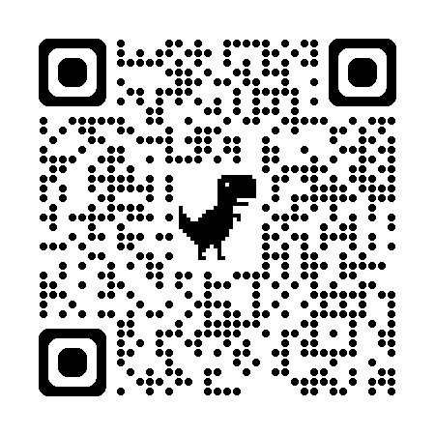
Contact information
TeamReach Coaches Group Code: “skippers25”
SYBA email address SpartaYouthBaseball@gmail.com
Facebook page “Sparta Youth Baseball Association”
Website - SpartaYouthBaseball.com

